Slide 1
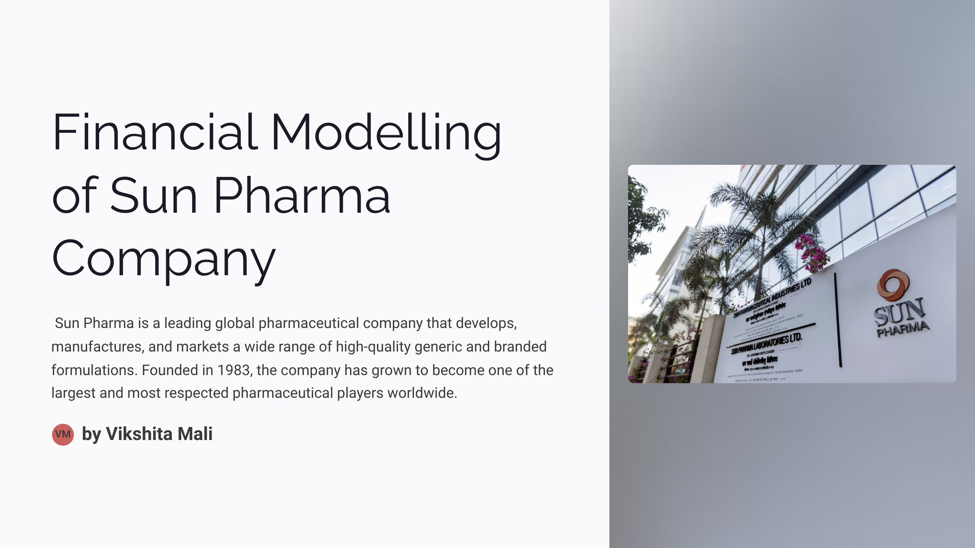



Slide 2








Agenda
Company Overview.
Historical Financial Statements and Ratio Analysis
Forecasting – Sales, EBITDA and EPS.
DCF (PV of FCFF, WACC, Sensitivity Analysis and Intrinsic Growth Rate)
Comparable Company Analysis
Conclusion
Football Field Analysis

Slide 3
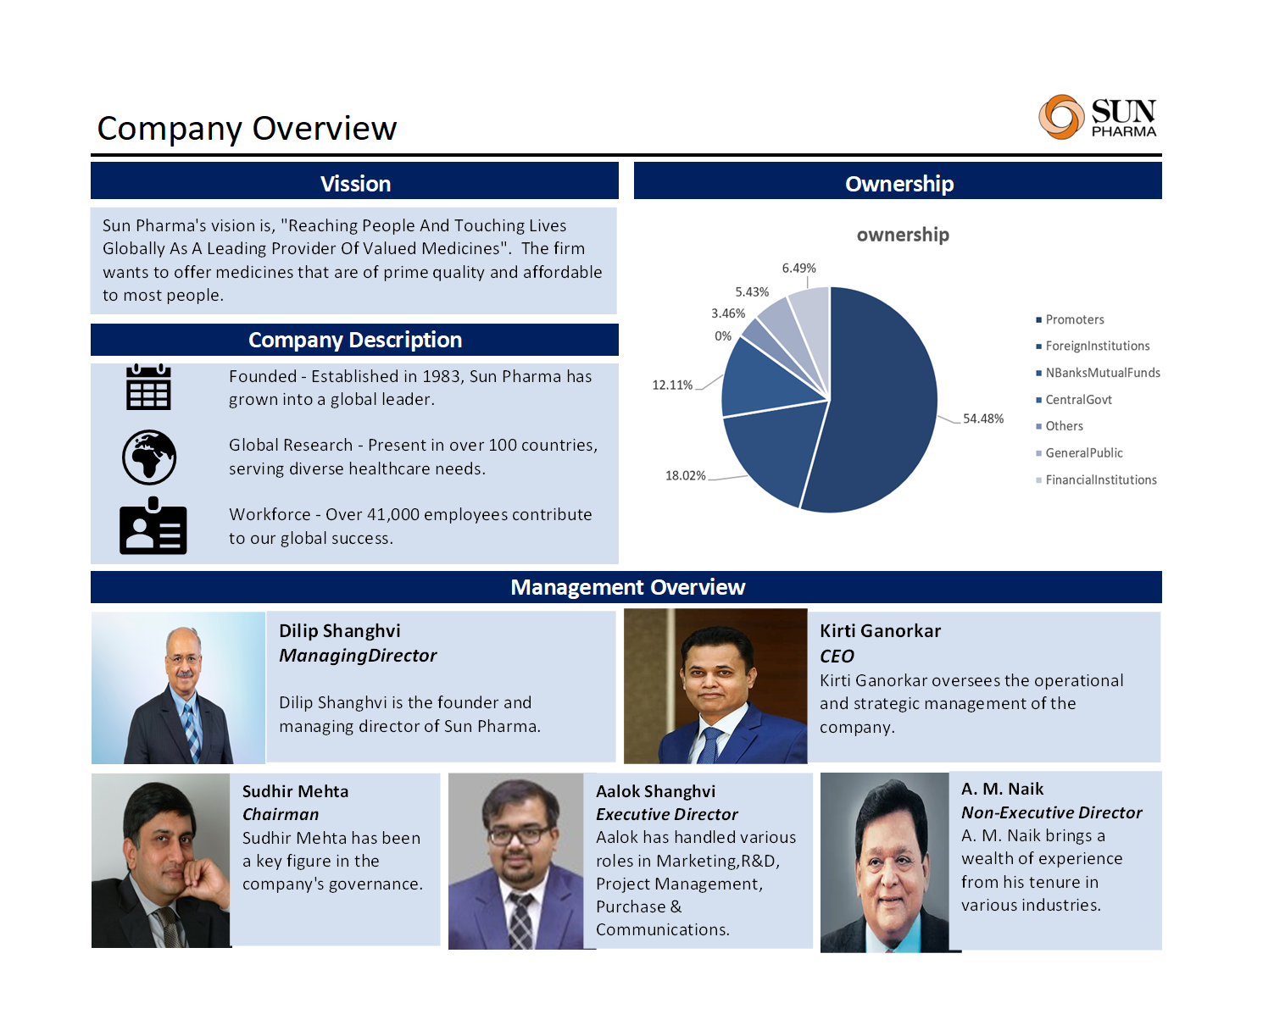

Slide 4
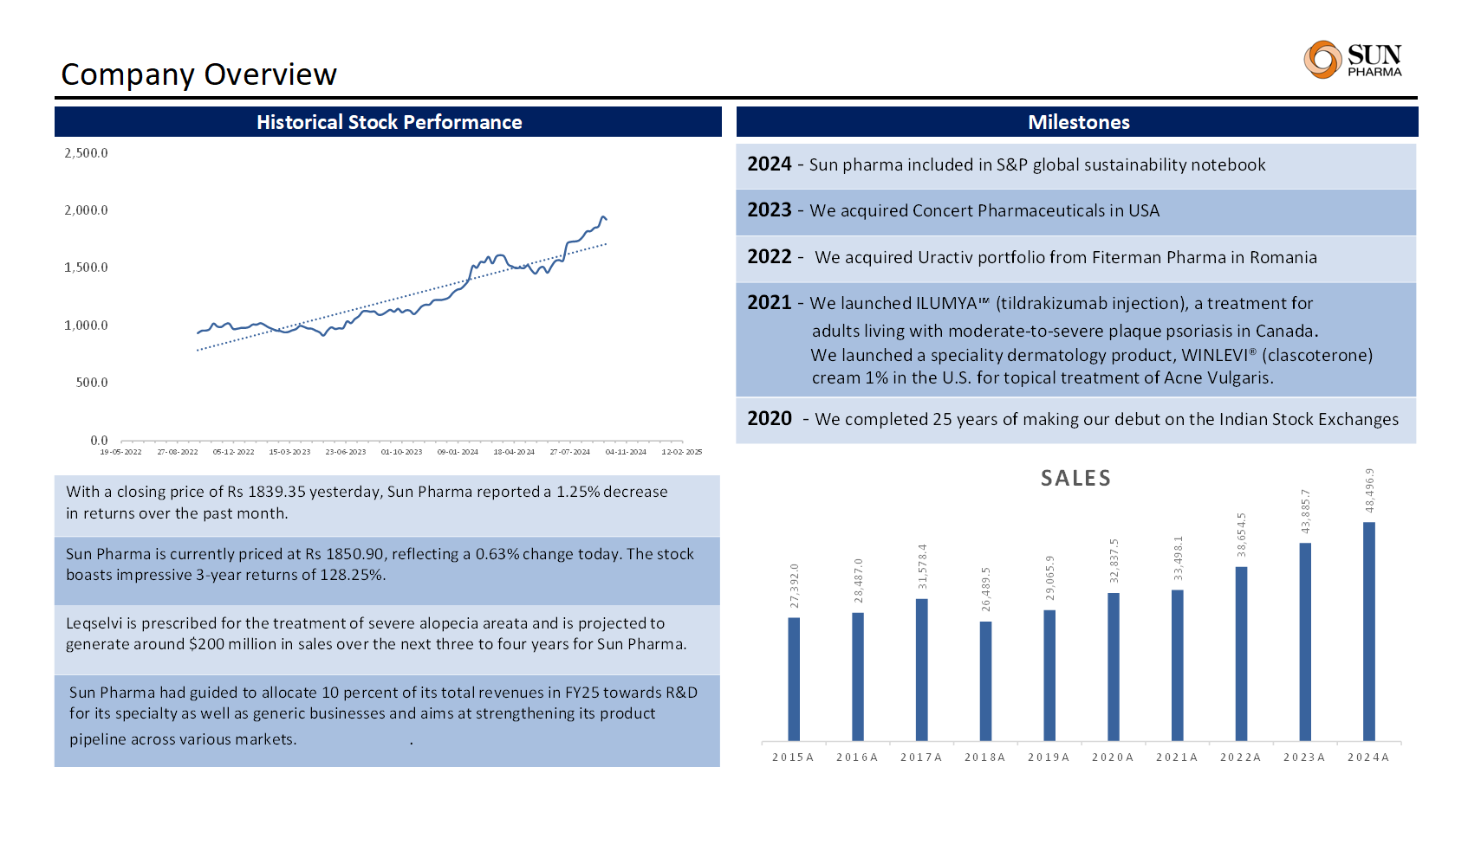

Slide 5
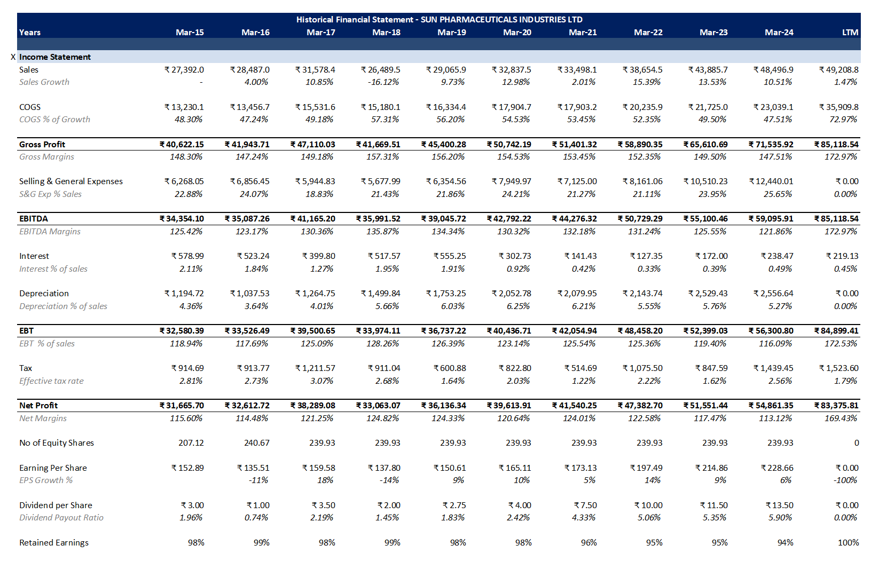
Historical Financial Statements

Slide 6
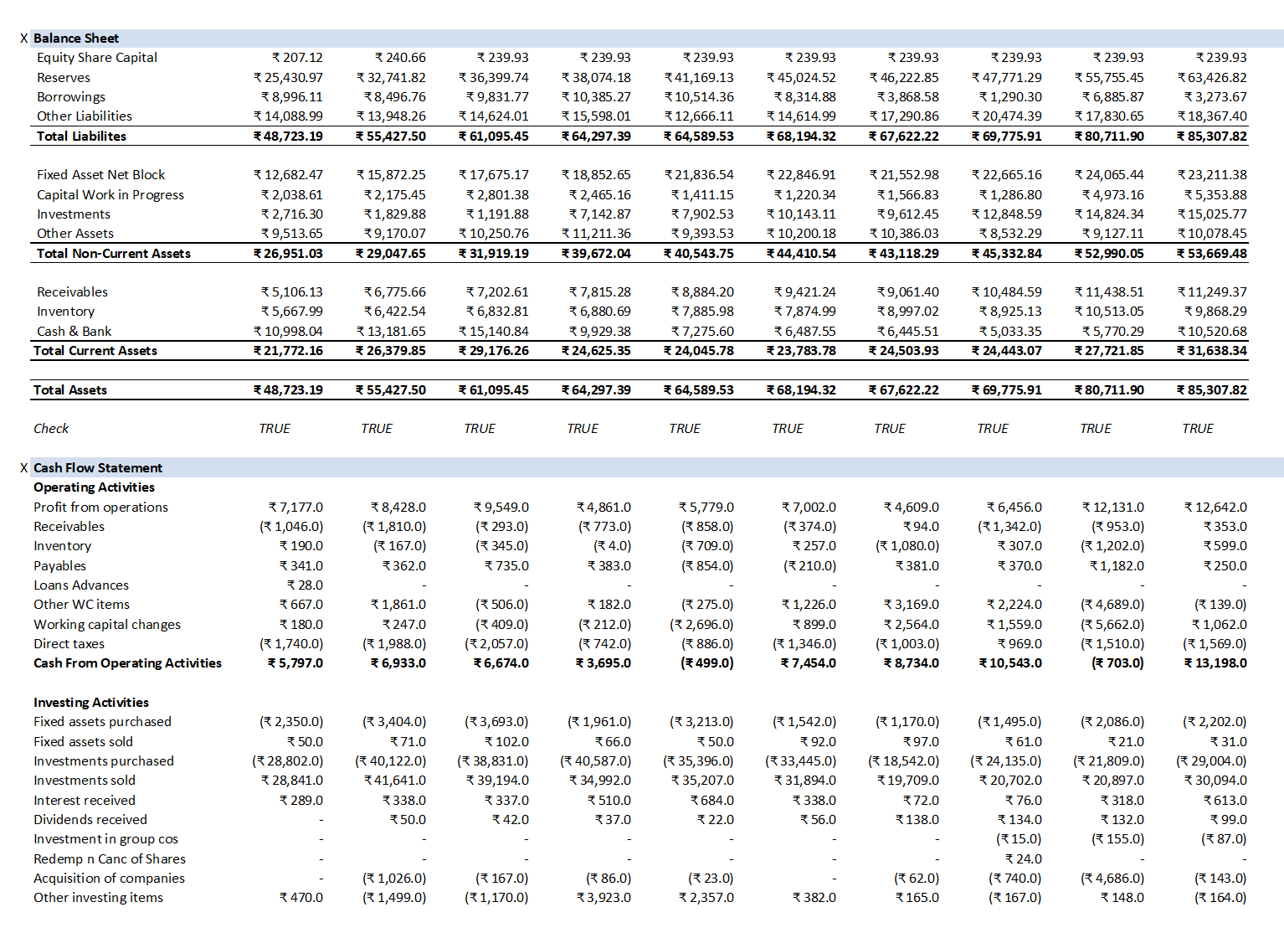

Slide 7
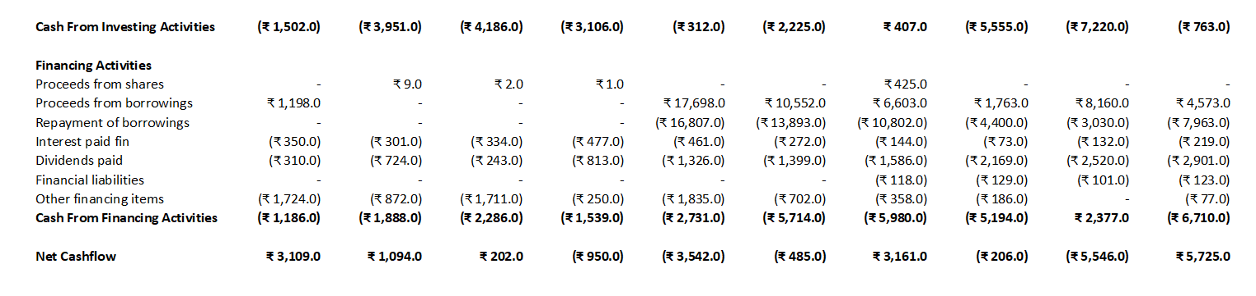
Why it’s needs to analysis Historical Financial statement?
By examining key financial metrics and trends over the years, we aim to understand the company's performance, growth trajectory, and financial health. The analysis covers revenue growth, profitability, liquidity, and other critical indicators that reflect the company's operational efficiency and market position.

Slide 8
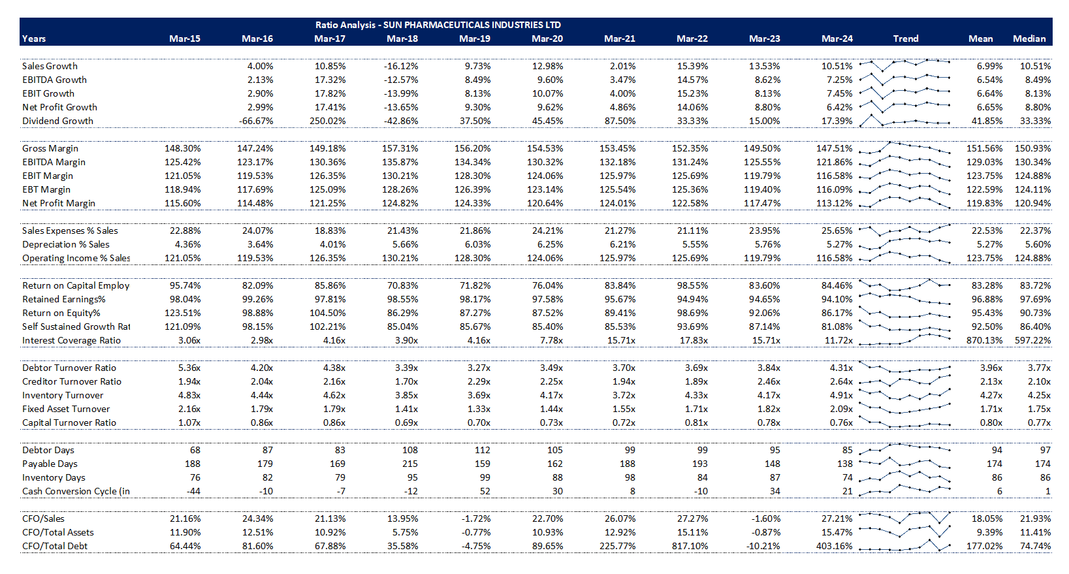
Ratio Analysis

Slide 9
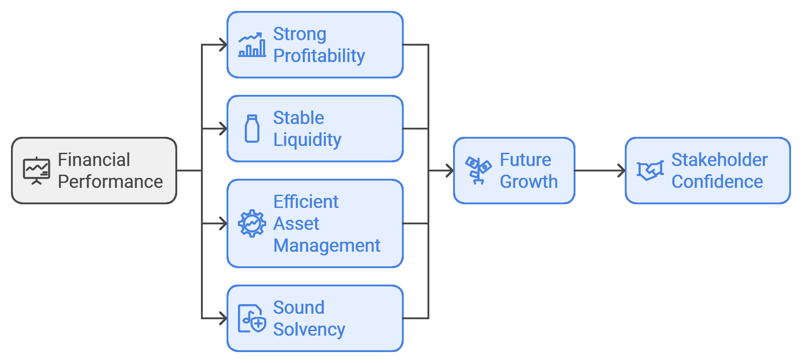
Conclusion from Ratio Analysis
The ratio analysis of Sun Pharmaceutical Industries from 2015 to 2024 indicates a generally positive financial performance. The company has demonstrated strong profitability, stable liquidity, efficient asset management, and sound solvency. These factors collectively suggest that Sun Pharmaceutical is well-positioned for future growth and stability in the pharmaceutical industry. Stakeholders can take confidence in the company's financial health as it navigates the evolving market landscape.

Slide 10
Net Revenue Projections
Sun Pharma has shown consistent growth in net revenue over the past few years, driven by its diverse product portfolio and expansion into emerging markets. Based on current market trends and the company's strategic initiatives, we project the following net revenue figures:
2024 to 2027: $5.5 billion to $7.0 billion
These projections are based on anticipated growth in key therapeutic areas, successful product launches, and an increase in market share.
Current Assets Projections
Current assets are crucial for assessing the liquidity and short-term financial health of Sun Pharma. Given the company's historical performance and expected revenue growth, we forecast the following current asset figures:
2024: $2.0 billion to $2.8 billion
The increase in current assets is expected to stem from higher cash reserves and receivables as sales grow.
Current Liabilities Projections
Current liabilities represent the company's short-term obligations. As Sun Pharma continues to expand, we anticipate the following figures for current liabilities:
2024: $1.5 billion to $2.1 billion
The rise in current liabilities is likely due to increased operational activities and investments in inventory to support sales growth.

Slide 11
Cash Flow Projections
Cash flow is a vital indicator of a company's financial health. Sun Pharma's cash flow from operations is expected to improve as net revenue increases. We project the following cash flow figures:
2024 to 2027: $1.0 billion to $1.6 billion
These projections reflect the anticipated operational efficiency and profitability of the company as it capitalizes on growth opportunities.

Slide 12
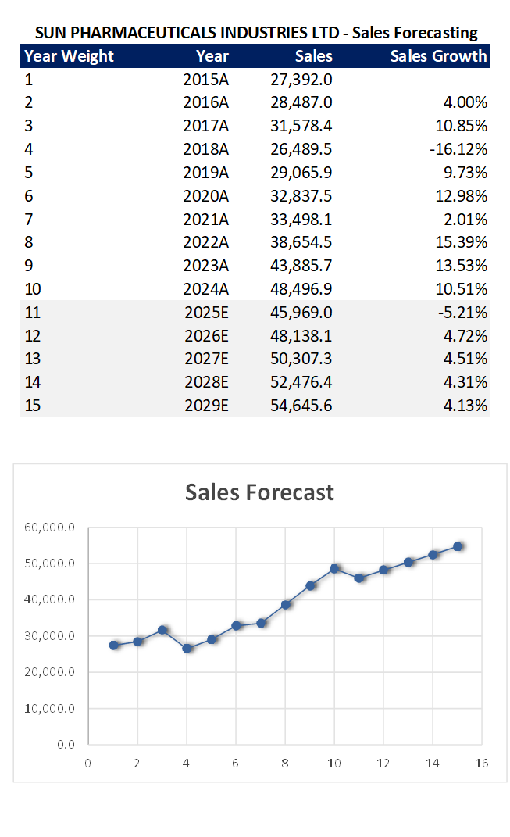
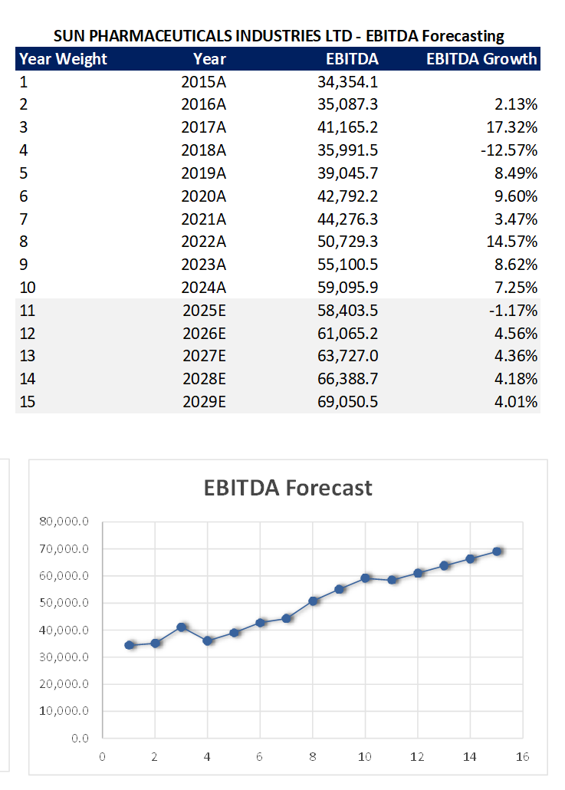
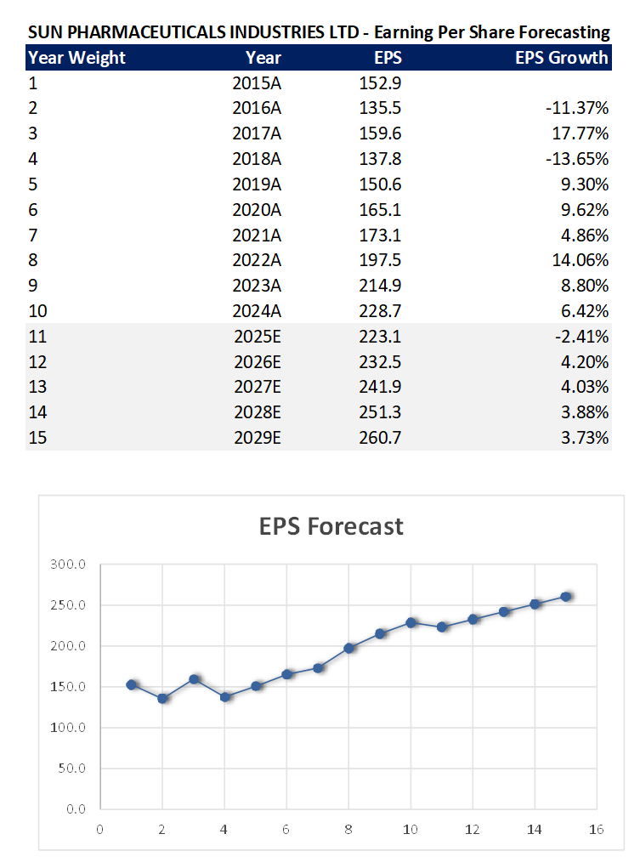

Slide 13
Sales Forecasting
EBITDA Forecasting
EPS Forecasting
2025-2029: Expected CAGR of 8-10% due to new product launches, expansion in emerging markets, and increased focus on specialty drugs.
2025-2029: Anticipated EBITDA margin improvement to around 25-27%, driven by operational efficiencies and higher-margin product sales.
2025-2029: Projected EPS growth of 10-12% annually, supported by increasing sales, improved margins, and share repurchase initiatives.

Slide 14
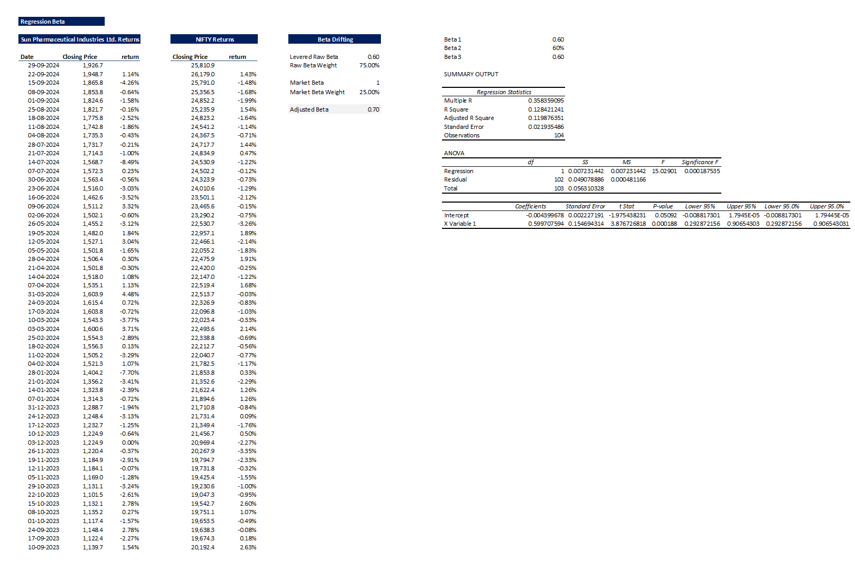
Valuation Analysis – Beta Drifting
The Beta is 0.60, so sun Pharmaceutical industries price
volatility has been lower than the market average.

Slide 15
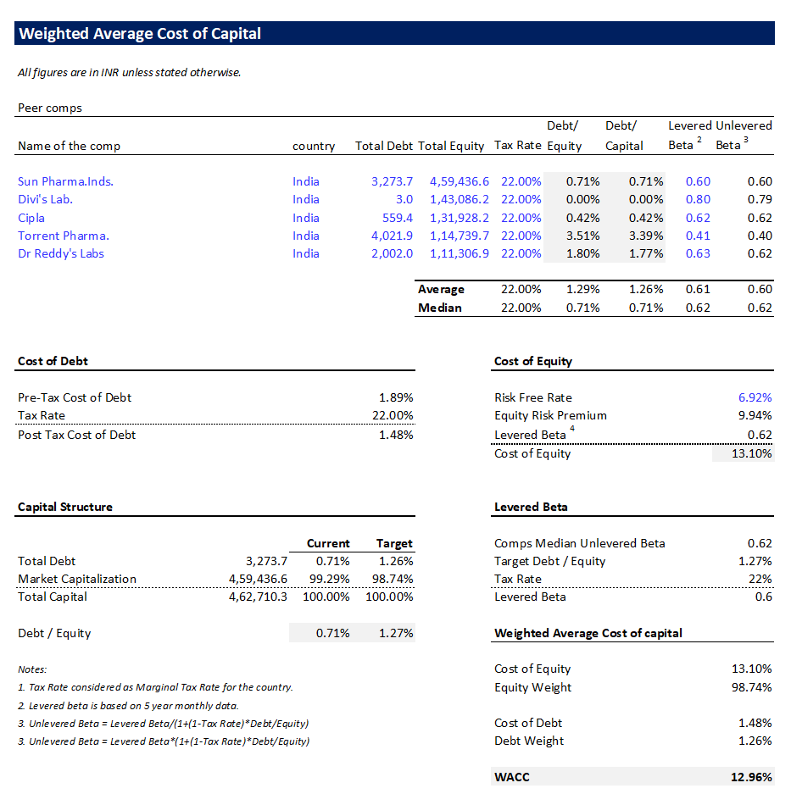
WACC –Weighted Average Cost of Capital

Slide 16
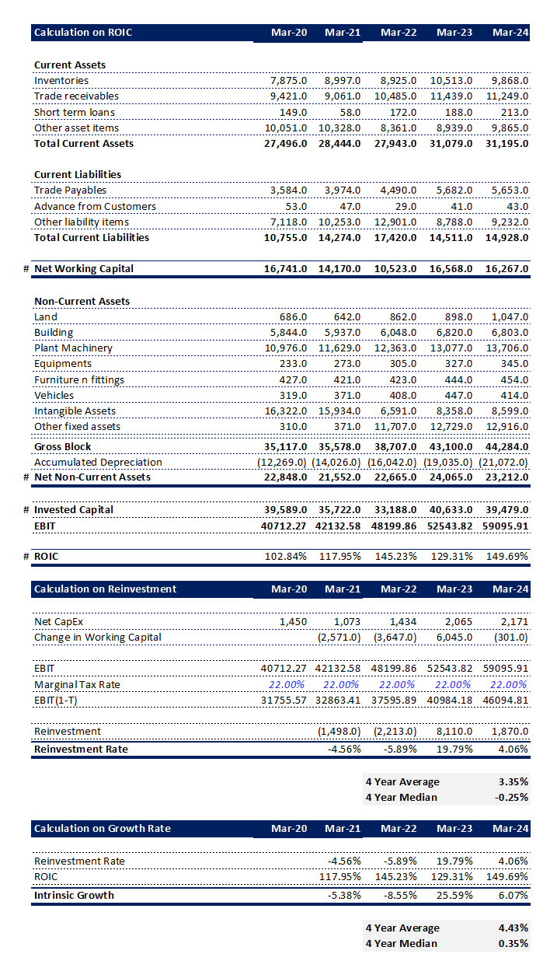

Slide 18
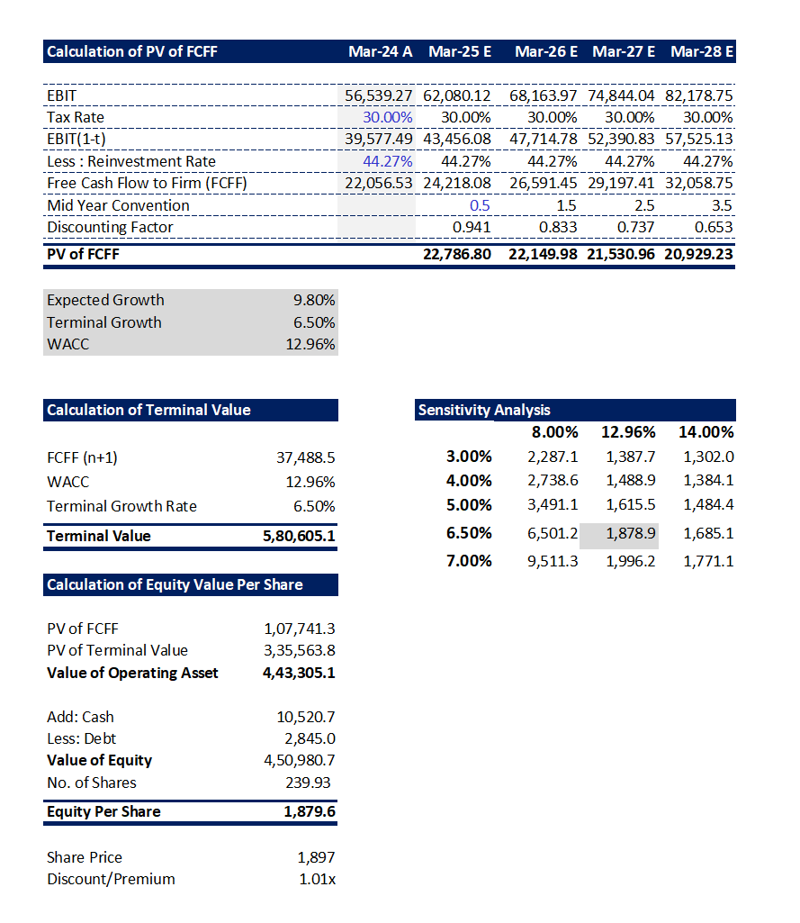

Slide 19
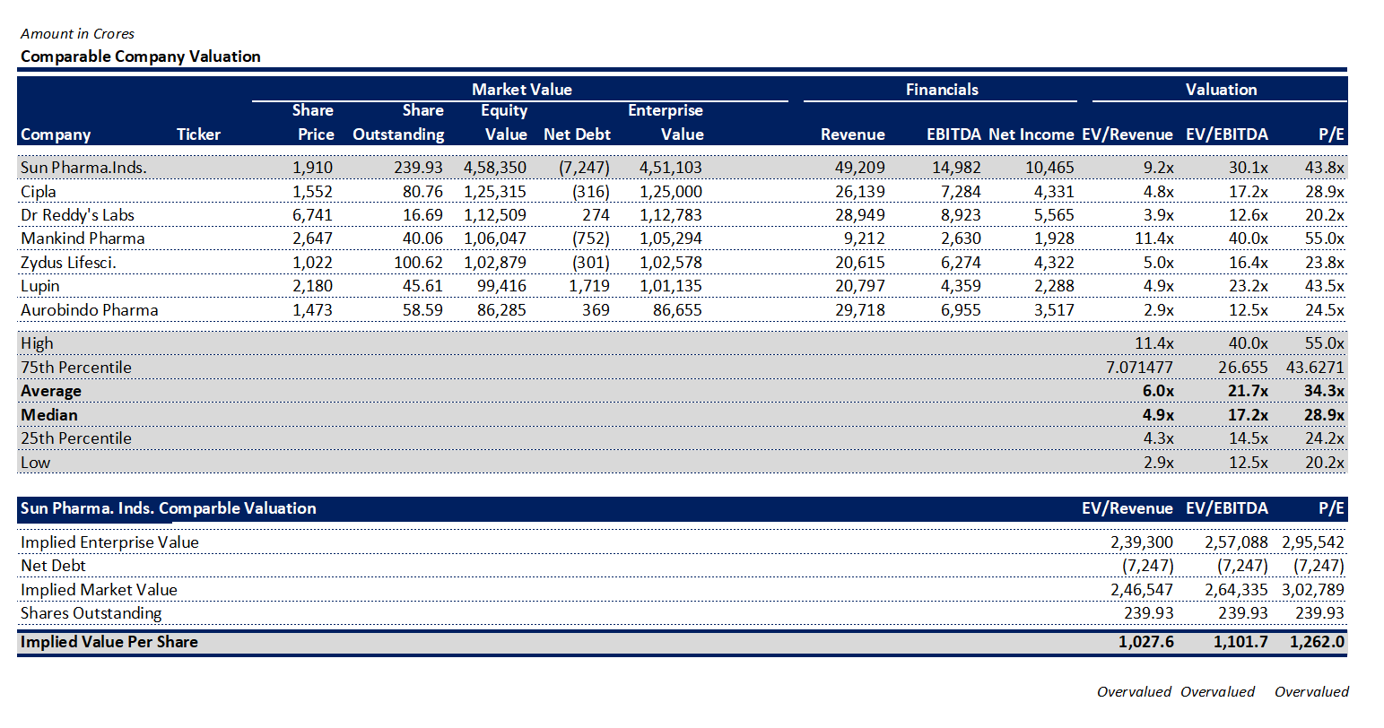

Slide 20
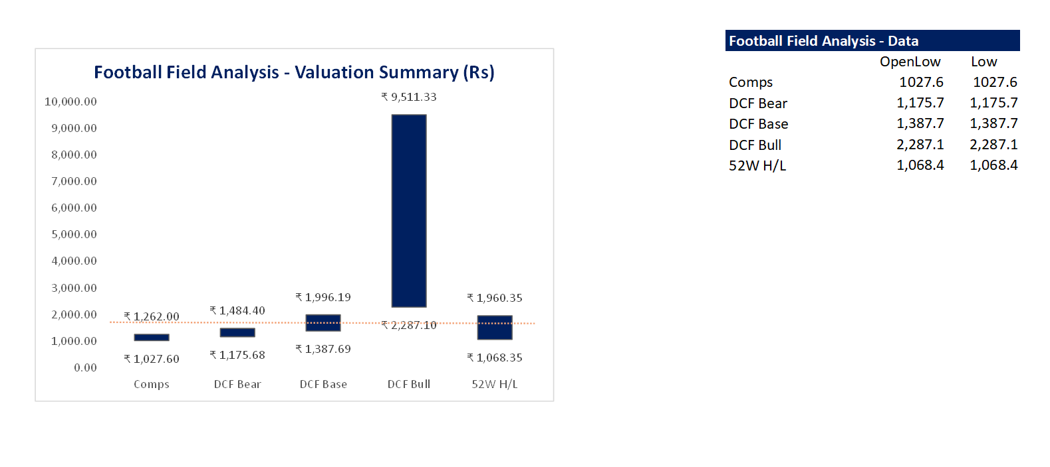
Football Field Analysis

Slide 21
